Slide 1
Computer Security Segment-2 Instructor: Taohidur Rahman

Slide 2
Symmetric Cipher Model
A symmetric encryption scheme has five ingredients (Figure 3.1):
■ Plaintext: This is the original intelligible message or data that is fed into the algorithm as input.
■ Encryption algorithm: The encryption algorithm performs various substitutions and transformations on the plaintext.

Slide 3
Secret key: The secret key is also input to the encryption algorithm. The key is a value independent of the plaintext and of the algorithm. The algorithm will produce a different output depending on the specific key being used at the time.
The exact substitutions and transformations performed by the algorithm depend on the key.

Slide 4
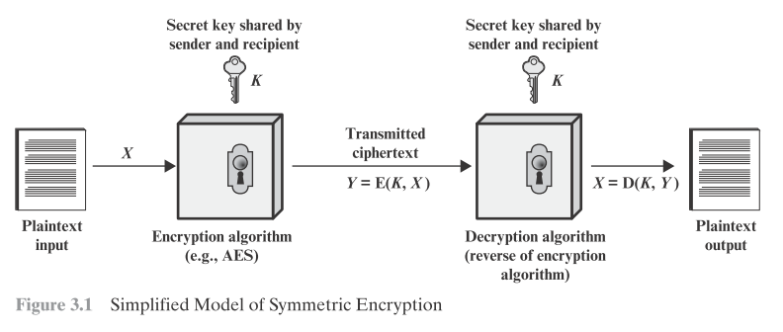

Slide 5
Ciphertext: This is the scrambled message produced as output. It depends on the plaintext and the secret key. For a given message, two different keys will produce two different ciphertexts.
The ciphertext is an apparently random stream of data and, as it stands, is unintelligible.
■ Decryption algorithm: This is essentially the encryption algorithm run in reverse. It takes the ciphertext and the secret key and produces the original plaintext.

Slide 6
There are two requirements for secure use of conventional encryption:
The opponent should be unable to decrypt ciphertext or discover the key even if he or she is in possession of a number of ciphertexts together with the plaintext that produced each ciphertext.
Sender and receiver must have obtained copies of the secret key in a secure fashion and must keep the key secure. If someone can discover the key and knows the algorithm, all communication using this key is readable.

Slide 7
We do not need to keep the algorithm secret; we need to keep only the key secret.
This feature of symmetric encryption is what makes it feasible for widespread use.
The fact that the algorithm need not be kept secret means that manufacturers can and have developed low-cost chip implementations of data encryption algorithms.

Slide 8
Let us take a closer look at the essential elements of a symmetric encryption scheme, using Figure 3.2. A source produces a message in plaintext, X = [X1, X2, XM]. The M elements of X are letters in some finite alphabet. Traditionally, the alphabet usually consisted of the 26 capital letters. Nowadays,

Slide 9
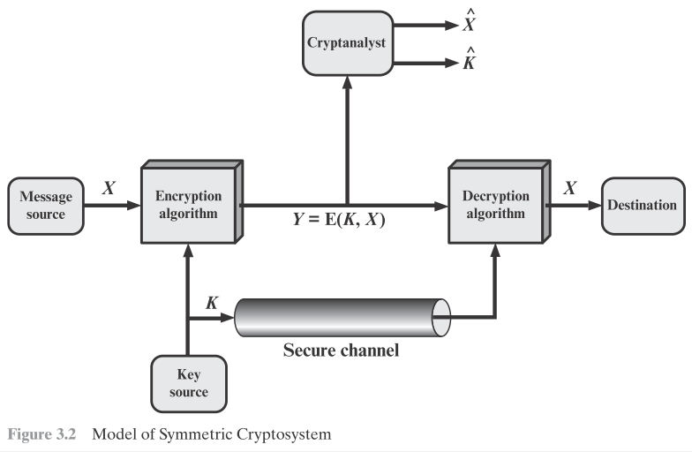

Slide 10
the binary alphabet {0, 1} is typically used. For encryption, a key of the form K = [K1, K2 , KJ] is generated. If the key is generated at the message source, then it must also be provided to the destination by means of some secure channel.
Alternatively, a third party could generate the key and securely deliver it to both source and destination. With the message X and the encryption key K as input, the encryption algorithm forms the ciphertext Y = [Y1, Y2 , YN]. We can write this as:
Y = E(K, X)

Slide 11
This notation indicates that Y is produced by using encryption algorithm E as a function of the plaintext X, with the specific function determined by the value of the key K.
The intended receiver, in possession of the key, is able to invert the transformation:
X = D(K, Y)
An opponent, observing Y but not having access to K or X, may attempt to recover X or K or both X and K. It is assumed that the opponent knows the encryption (E) and decryption (D) algorithms.

Slide 12
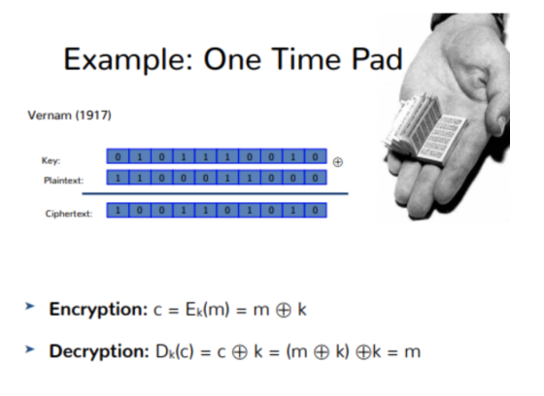

Slide 13
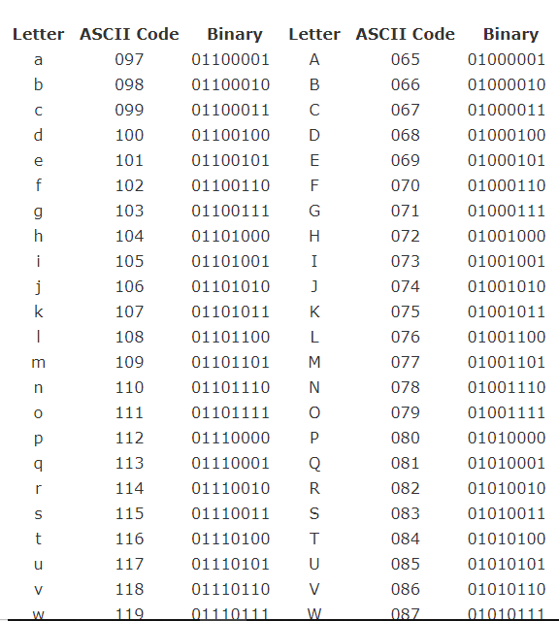

Slide 14
A pseudorandom generator inputs a seed and outputs an expanded stream of bits. The output should be pseudorandom in the sense that it is not possible to distinguish the output from a truly randomly generated sequence of bits in a computationally feasible amount of time. The pseudorandom generator can be used to implement a stream cipher.

Slide 15
The basic idea of a stream cipher is that we apply the pseudorandom generator to the short key, to expand the key into a pseudorandom stream as long as the message. Then we XOR the expanded key with the message to get the ciphertext as the result, just like a one-time pad, except now with a pseudorandomly generated pad.

Slide 16
We still need to be careful about security with this construction. What if we use the same key twice? Imagine that we use a key k twice to encrypt two different messages, M1 and M2, with the same key stream to obtain two ciphertexts C1 = M1 ⊕ P RG(k) and C2 = M2 ⊕ P RG(k). Then C1 ⊕ C2 = M1 ⊕ M2, that is, the key streams are canceled out.

Slide 17
From M1 ⊕ M2, what can we learn? The distribution of, say, English text or ASCII characters is very non-random, and an adversary can use frequency analysis or similar to derive likely sequences of plaintext that would result in the observed xored messages.

Slide 18
If the opponent is interested in only this particular message, then the focus of the effort is to recover X by generating a plaintext estimate X_{e}.
Often, however, the opponent is interested in being able to read future messages as well, in which case an attempt is made to recover K by generating an estimate K_{e.}

Slide 19
Cryptanalysis and Brute-Force Attack
■ Cryptanalysis: Cryptanalytic attacks rely on the nature of the algorithm plus perhaps some knowledge of the general characteristics of the plaintext or even some sample plaintext–ciphertext pairs. This type of attack exploits the characteristics of the algorithm to attempt to deduce a specific plaintext or to deduce the key being used.
■ Brute-force attack: The attacker tries every possible key on a piece of ciphertext until an intelligible translation into plaintext is obtained. On average, half of all possible keys must be tried to achieve success.

Slide 20
■ An encryption scheme is unconditionally secure if the ciphertext generated by the scheme does not contain enough information to determine uniquely the corresponding plaintext, no matter how much ciphertext is available.
Therefore, all that the users of an encryption algorithm can strive for is an algorithm that meets one or both of the following criteria:
■ The cost of breaking the cipher exceeds the value of the encrypted information.

Slide 21
■ The time required to break the cipher exceeds the useful lifetime of the information.
An encryption scheme is said to be computationally secure if either of the foregoing two criteria are met.

Slide 22
Substitution Cipher- Case 1. Caesar (Shift Cipher) Cipher
A substitution technique is one in which the letters of plaintext are replaced by other letters or by numbers or symbols.

Slide 23
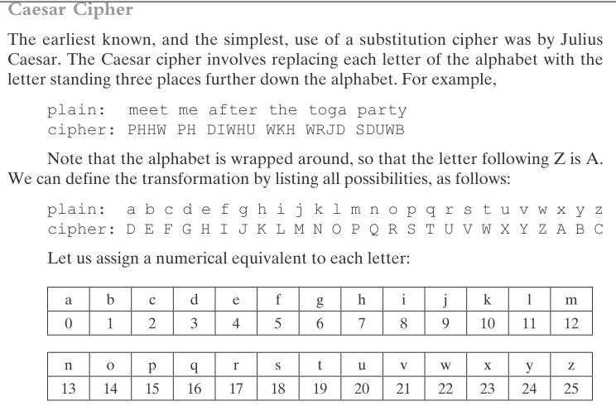

Slide 24
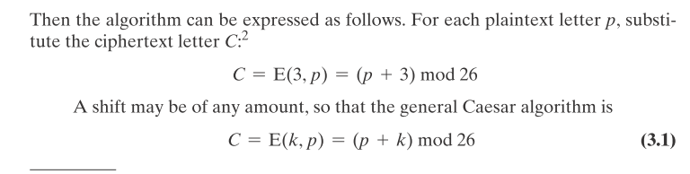
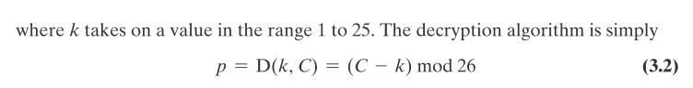

Slide 25
If it is known that a given ciphertext is a Caesar cipher, then a brute-force cryptanalysis is easily performed: simply try all the 25 possible keys. Figure 3.3 shows the results of applying this strategy to the example ciphertext. In this case, the plaintext leaps out as occupying the third line.Three important characteristics of this problem enabled us to use a brute-force cryptanalysis:
1. The encryption and decryption algorithms are known.
2. There are only 25 keys to try.
3. The language of the plaintext is known and easily recognizable.

Slide 26
In most networking situations, we can assume that the algorithms are known. What generally makes brute-force cryptanalysis impractical is the use of an algorithm that employs a large number of keys.

Slide 27
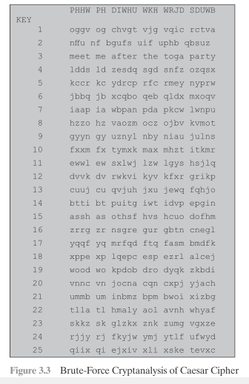

Slide 28
Another Substitution Cipher
The goal of the substitution cipher is the encryption of text (as opposed to bits in modern digital systems). The idea is very simple: We substitute each letter of the
alphabet with another one.
Example 1.1.
A → K

Slide 29
Another Substitution Cipher
Let’s determine the key space of the substitution cipher: When choosing the replacement for the ﬁrst letter A, we randomly choose one letter from the 26 letters of the alphabet (in the example above we chose k).
The replacement for the next alphabet letter B was randomly chosen from the remaining 25 letters, etc. Thus there exist the following number of different substitution tables:
key space of the substitution cipher = 26 · 25···3 · 2 · 1 = 26! ≈ 2^88

Slide 30
Another Substitution Cipher
Even with hundreds of thousands of high-end PCs such a search would take several decades! Thus, we are tempted to conclude that the substitution cipher is secure. But this is incorrect because there is another, more powerful attack.

Slide 31
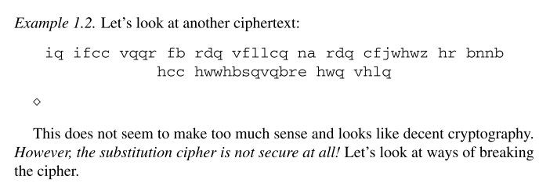

Slide 32
Cryptanalyzing this substitution cipher
The statistical properties of the plaintext are preserved in the ciphertext. If we go back to the second example we observe that the letter q occurs most frequently in the text. From this we know that q must be the substitution for one of the frequent letters in the English language.

Slide 33
Cryptanalyzing this substitution cipher
For practical attacks, the following properties of language can be exploited:
1. Determine the frequency of every ciphertext letter. The frequency distribution, often even of relatively short pieces of encrypted text, will be close to that of the given language in general.
In particular, the most frequent letters can often easily be spotted in ciphertexts. For instance, in English E is the most frequent letter (about 13%), Tis the second most frequent letter (about 9%).

Slide 34
Cryptanalyzing this substitution cipher
2. The method above can be generalized by looking at pairs or triples, or quadruples, and so on of ciphertext symbols. For instance, in English (and some other European languages), the letter Q is almost always followed by a U. This behavior can be exploited to detect the substitution of the letter Q and the letter U.
3. If we assume that word separators (blanks) have been found (which is only sometimes the case), one can often detect frequent short words such as THE, AND, etc.

Slide 35
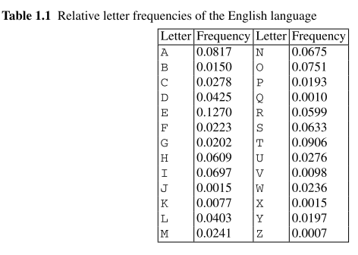
Cryptanalyzing this substitution cipher

Slide 36
Transposition Techniques
All the techniques examined so far involve the substitution of a ciphertext symbol for a plaintext symbol. A very different kind of mapping is achieved by performing some sort of permutation on the plaintext letters. This technique is referred to as a transposition cipher. The simplest such cipher is the rail fence technique, in which the plaintext is written down as a sequence of diagonals and then read off as a sequence of rows. For example, to encipher the message “meet me after the toga party” with a rail fence of depth 2, we write the following:

Slide 37
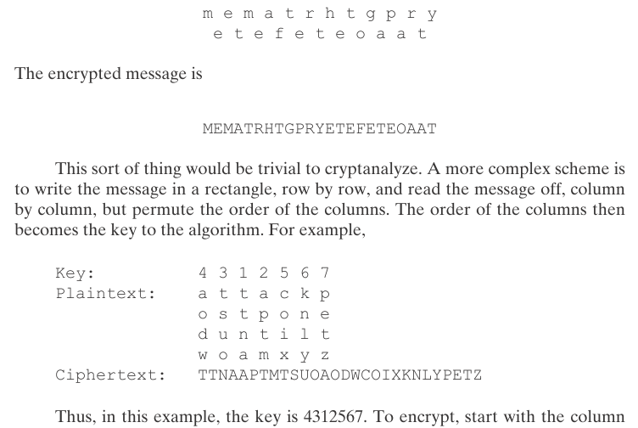

Slide 38
A pure transposition cipher is easily recognized because it has the same letter frequencies as the original plaintext. For the type of columnar transposition just shown, cryptanalysis is fairly straightforward and involves laying out the ciphertext in a matrix and playing around with column positions. Digram and trigram frequency tables can be useful [See the following figure from ref-2].
The transposition cipher can be made significantly more secure by performing more than one stage of transposition.

Slide 39
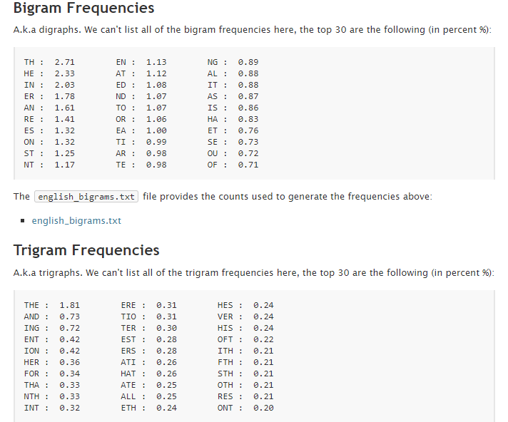
Fig-1: Bigram and Trigram frequencies [2]

Slide 40
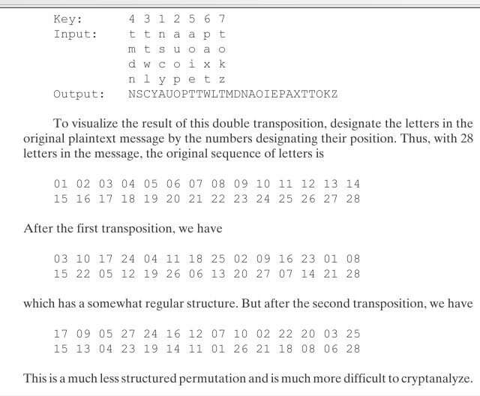

Slide 41
Stream and Block Ciphers
A stream cipher is one that encrypts a digital data stream one bit or one byte at a time.
A block cipher is one in which a block of plaintext is treated as a whole and used to produce a ciphertext block of equal length. Typically, a block size of 64 or 128 bits is used. As with a stream cipher, the two users share a symmetric encryption key.
In general, they seem applicable to a broader range of applications than stream ciphers.

Slide 42
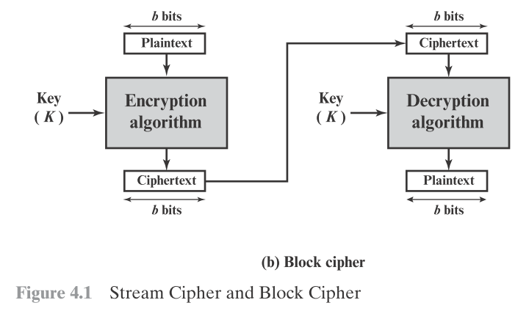

Slide 43
Block Cipher
A block cipher operates on a plaintext block of n bits to produce a ciphertext block of n bits. There are 2^{n} possible different plaintext blocks and, for the encryption to be reversible (i.e., for decryption to be possible), each must produce a unique ciphertext block. Such a transformation is called reversible, or nonsingular.
The following examples illustrate nonsingular and singular transformations for n = 2:

Slide 44
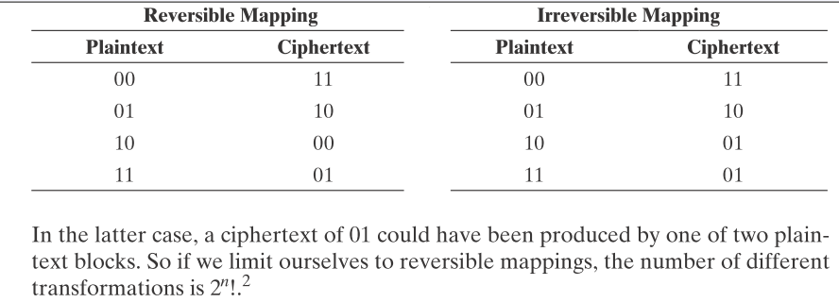
The reasoning is as follows: For the first plaintext, we can choose any of 2^{n} ciphertext blocks. For the
second plaintext, we choose from among 2^{n} -1 remaining ciphertext blocks, and so on.

Slide 45
Block Cipher
Figure 4.2 illustrates the logic of a general substitution cipher for n = 4.
A 4-bit input produces one of 16 possible input states, which is mapped by the substitution cipher into a unique one of 16 possible output states, each of which is represented by 4 ciphertext bits. The encryption and decryption mappings can be defined by a tabulation, as shown in Table 4.1.

Slide 46
Block Cipher
This is the most general form of block cipher and can be used to define any reversible mapping between plaintext and ciphertext. Feistel refers to this as the ideal block cipher, because it allows for the maximum number of possible encryption mappings from the plaintext block.

Slide 47
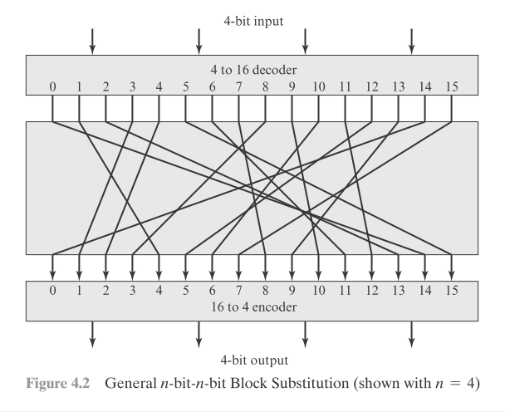

Slide 48
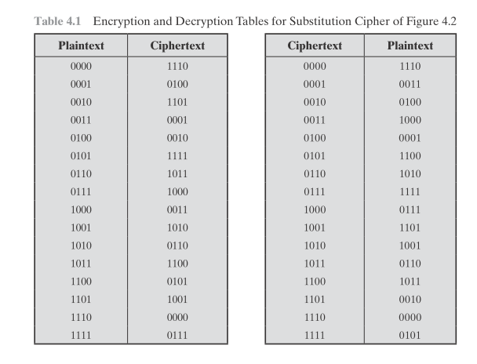

Slide 49
But there is a practical problem with the ideal block cipher. If a small block size, such as n = 4, is used, then the system is equivalent to a classical substitution cipher. Such systems, as we have seen, are vulnerable to a statistical analysis of the plaintext.
If n is sufficiently large and an arbitrary reversible substitution between plaintext and ciphertext is allowed, then the statistical characteristics of the source plaintext are masked to such an extent that this type of cryptanalysis is infeasible.

Slide 50
An arbitrary reversible substitution cipher (the ideal block cipher) for a large block size is not practical, however, from an implementation and performance point of view. For such a transformation, the mapping itself constitutes the key. Consider again Table 4.1, which defines one particular reversible mapping from plaintext to ciphertext for n = 4. The mapping can be defined by the entries in the second column, which show the value of the ciphertext for each plaintext block.

Slide 51
This, in essence, is the key that determines the specific mapping from among all possible mappings. In this case, using this straightforward method of defining the key, the required key length is (4 bits) * (16 rows) = 64 bits. In general, for an n-bit ideal block cipher, the length of the key defined in this fashion is n * 2^n bits. For a 64-bit block, which is a desirable length to thwart statistical attacks, the required key length is 64 * 2^64 = 2^70 ≈ 10^21 !!!!!(WOW).

Slide 52
See Sheet Ideal Block Cipher Example-1.

Slide 53
In considering these difficulties, Feistel points out that what is needed is an approximation to the ideal block cipher system for large n.

Slide 54
Feistel Cipher Structure
Read page 7-13 from Lecture-3 of Prof. Avi Kak.

Slide 55
Some parameters of Feistel network are Block size, number of rounds, subkey generation algorithm, round function F.

Slide 56
Data Encryption Standard (DES)
The overall scheme for DES encryption is illustrated in Figure 4.5. As with any encryption scheme, there are two inputs to the encryption function: the plaintext to be encrypted and the key. In this case, the plaintext must be 64 bits in length and the key is 56 bits in length.

Slide 57
Data Encryption Standard (DES)
Looking at the left-hand side of the figure, we can see that the processing of the plaintext proceeds in three phases. First, the 64-bit plaintext passes through an initial permutation (IP) that rearranges the bits to produce the permuted input.

Slide 58
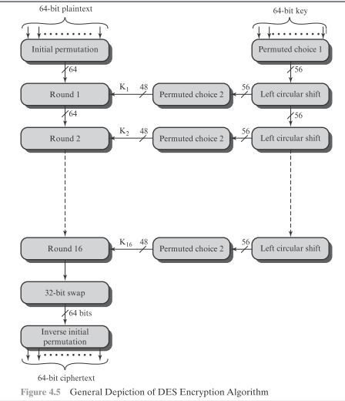

Slide 59
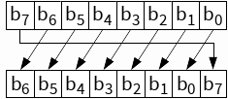
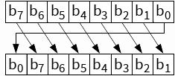
Left and right circular shift

Slide 60
Data Encryption Standard (DES)
This is followed by a phase consisting of sixteen rounds of the same function, which involves both permutation and substitution functions. The output of the last (sixteenth) round consists of 64 bits that are a function of the input plaintext and the key. The left and right halves of the output are swapped to produce the output.

Slide 61
Data Encryption Standard (DES)
Finally, the pre output is passed through a permutation [IP⁻¹] that is the inverse of the initial permutation function, to produce the 64-bit ciphertext. With the exception of the initial and final permutations, DES has the exact structure of a Feistel cipher, as shown in Figure 4.3.

Slide 62
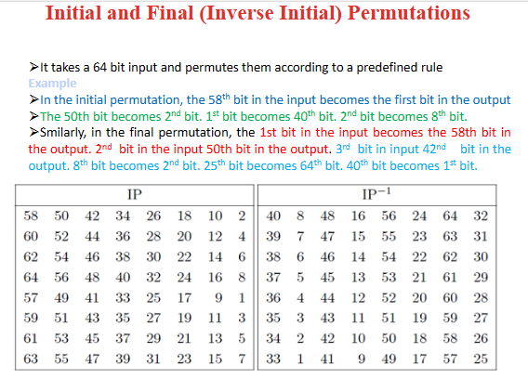
Inverse Initial permutation

Slide 63
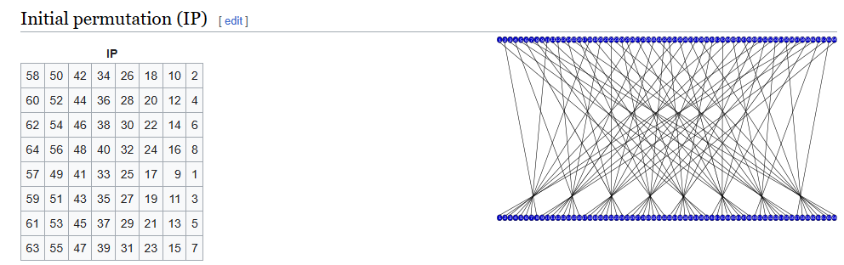
Inverse Initial permutation

Slide 64
Simplified details of DES
See video “Simplified DES Example best” by Steven Gordon (CQ university).

Slide 65
References and disclaimer
All resources used here are properties of the respective owners. Those are used here for educational purpose.
References:
1. Cryptography and Network Security, Principles and Practice (7th Edition)
-William Stallings.
2. https://onlinetoolz.net/bitshift
3.https://mathworld.wolfram.com/InversePermutation.html#:~:text=An%20inverse%20permutation%20is%20a,and%2010%20in%20are%20likewise
4. Symmetriccrypto-notes.pdf (ucsd.edu)

